Slide 1


Slide 2

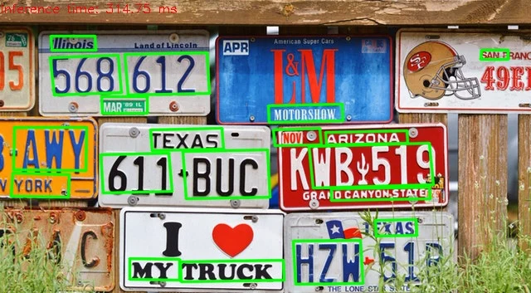
Introduction
Text Detection is a technology related to computer vision and image processing that deals with detecting text in digital images and videos.
Using the real time webcam data, we have implemented a text detection application in videos.
It uses OpenCV library and a deep learning based text detector called EAST : An Efficient and Accurate Text Detector for real time text detection in the video.

Slide 3



Software/Tools
The programming is done in Python 3.8 using OpenCV and NumPy library.

Slide 4
Software/Tools
EAST Text Detector
A pre-trained deep learning based model called EAST “ Efficient and Accurate Scene Text “ detection pipeline is used.
It is based on convolutional Neural Network (CNN) and is capable of running at 13 FPS.
It is a two stage pipeline used to detect words at arbitrary orientations:
In the first stage, the image is fed to the model and it detects the text region.
In the second stage, the multiple boxes are suppressed in order to create one box around the detected text.

Slide 5
Applications of Text Detection
Automated Assistance
Video Analysis
Recognizing Signs in Driver Assisted Systems
Identifying Vehicles by reading their License Plates
Providing Scene Information to Visually Impaired people

Slide 6
THANK YOU!!!

